Slide 1

R 선형판별분석 (1),(2)
파이썬 선형판별분석
참고: SAS 및 SPSS 판별분석

Slide 3
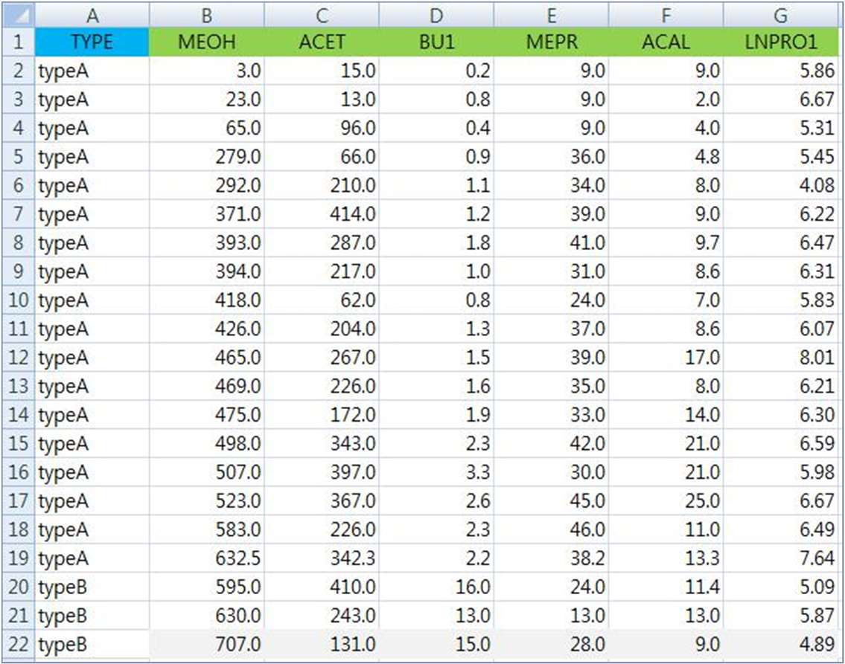

Slide 4

alcohol = read.csv(“c:/data/mva/alcohol.csv")
head(alcohol)
TYPE | MEOH | ACET | BU1 | MEPR | ACAL | LNPRO1
1 typeA | 3 | 15 | 0.2 | 9 | 9.0 | 5.86
2 typeA | 23 | 13 | 0.8 | 9 | 2.0 | 6.67
3 typeA | 65 | 96 | 0.4 | 9 | 4.0 | 5.31
4 typeA | 279 | 66 | 0.9 | 36 | 4.8 | 5.45
5 typeA | 292 | 210 | 1.1 | 34 | 8.0 | 4.08
6 typeA | 371 | 414 | 1.2 | 39 | 9.0 | 6.22
summary(alcohol)
TYPE Length:77 |  | MEOH Min. : |  |  |  | 3.0 | Min. | ACET : 13.0 | Min. | BU1 : 0.20
Class :character |  |  | 1st Qu.: |  | 620.0 |  | 1st Qu.:127.0 |  | 1st Qu.: 9.30
Mode :character |  |  | Median : |  | 910.0 |  | Median :181.0 |  | Median :17.00
 |  |  | Mean : |  | 845.6 |  | Mean :211.7 |  | Mean :14.74
3rd Qu.:1087.0 |  |  |  |  |  |  | 3rd Qu.:287.0 |  | 3rd Qu.:20.00
Max. :1548.0 |  |  |  |  |  |  | Max. :495.0 |  | Max. :30.00
▪
▪

Slide 5
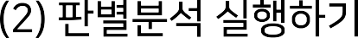


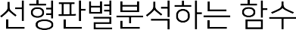

library(MASS)
alcohol_lda = lda(TYPE~ . , data=alcohol)
alcohol_lda
Prior probabilities of groups: typeA typeB typeC
0.2337662 0.3766234 0.3896104
“
•
Group means:
MEOH ACET BU1 MEPR ACAL LNPRO1 typeA 378.6944 218.0167 1.511111 32.06667 11.16667 6.231111
typeB 939.1379 247.3448 17.906897 30.55172 12.54138 4.883103
typeC 1035.4000 173.3667 19.620000 43.00000 13.27333 5.145667
•
Coefficients of linear discriminants:
•
 | LD1 | LD2
MEOH | 3.382089e-03 | 0.0005710473
ACET | -4.649248e-05 | -0.0066573606
BU1 | 1.322048e-01 | -0.0162598664
MEPR | -2.562255e-02 | 0.0533609640
ACAL | -4.048757e-02 | 0.0297883525
LNPRO1 | -2.791911e-01 | 0.3894400487
Proportion of trace: LD1 LD2
0.9168 0.0832

Slide 6


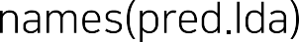
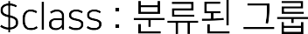
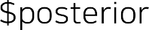
pred_lda = predict(alcohol_lda, newdata=alcohol)
names(pred_lda)
[1] "class" "posterior" "x"
head(pred_lda$class)
[1] typeA typeA typeA typeA typeA typeA Levels: typeA typeB typeC
•
•
head(pred_lda$posterior)
typeA | typeB | typeC
1 0.9999932 | 4.878233e-06 | 1.882559e-06
2 0.9999838 | 1.104519e-05 | 5.137599e-06
3 0.9998621 | 1.216151e-04 | 1.626668e-05
4 0.9999067 | 3.768926e-05 | 5.562616e-05
5 0.9993267 | 5.527433e-04 | 1.205654e-04
6 0.9999181 | 7.058307e-05 | 1.131889e-05
head(pred_lda$x)
LD1 | LD2
1 -4.091901 | -0.2497072
2 -3.887575 | -0.1277995
3 -3.503543 | -1.1199342
4 -3.475565 | 0.7129591
5 -3.107675 | -0.7864612
6 -3.602823 | -0.9710812
•
•
•

Slide 7
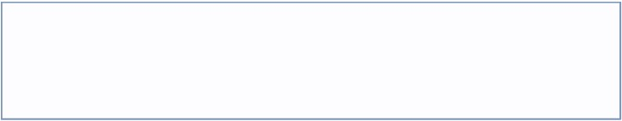



indep_vars = alcohol[,-1]
alcohol_man <- manova(as.matrix(indep_vars) ~ pred_lda$class)
alcohol_wilks = summary(alcohol_man, test="Wilks")
alcohol_wilks
Df Wilks approx F num Df den Df Pr(>F) pred_lda$class 2 0.067655 32.713 12 138 < 2.2e-16 ***
Residuals 74
Wilks Lambda
confm_lda = table(alcohol$TYPE, pred_lda$class)
confm_lda
 | typeA | typeB |  | typeC
typeA | 18 | 0 |  | 0
typeB | 0 | 23 |  | 6
typeC #error | 0 rate | 9 |  | 21
prop.table(confm_lda,1)
 | typeA |  | typeB |  | typeC
typeA | 1.0000000 |  | 0.0000000 |  | 0.0000000
typeB | 0.0000000 |  | 0.7931034 |  | 0.2068966
typeC | 0.0000000 |  | 0.3000000 |  | 0.7000000
error = 1-sum(diag(confm_lda))/sum(
•
confm_lda)
•
error
[1] 0.1948052

Slide 8


library(klaR)
alcohol_forward = greedy.wilks(TYPE~. , data=alcohol, niveau=0.01)
alcohol_forward
…
Values calculated in each step of the selection procedure:
vars Wilks.lambda F.statistics.overall p.value.overall F.statistics.diff p.value.diff
1 | BU1 | 0.2989919 | 86.74917 | 3.975561e-20 | 86.749173 | 3.975561e-20
2 | MEPR | 0.2489312 | 36.65654 | 3.402765e-21 | 7.340239 | 1.235768e-03
3 | MEOH | 0.2012539 | 29.49819 | 7.226240e-23 | 8.528444 | 4.692630e-04
4 | ACET | 0.1807787 | 23.99695 | 5.401388e-23 | 4.020776 | 2.211118e-02
5 | LNPRO1 | 0.1615413 | 20.83263 | 2.981802e-23 | 4.168035 | 1.942952e-02
> ▪
▪
▪

Slide 9


alcohol_fwd_lda = lda(alcohol.forward$formula, data=alcohol.data)
alcohol_fwd_lda
Call:
lda(alcohol.forward$formula, data = alcohol.data)
Prior probabilities of groups: typeA typeB typeC
0.2337662 0.3766234 0.3896104
Group | means:
 | BU1 | MEPR | MEOH | ACET | LNPRO1
typeA | 1.511111 | 32.06667 | 378.6944 | 218.0167 | 6.231111
typeB | 17.906897 | 30.55172 | 939.1379 | 247.3448 | 4.883103
typeC | 19.620000 | 43.00000 | 1035.4000 | 173.3667 | 5.145667
Coefficients of linear discriminants:
 | LD1 | LD2
BU1 | 0.1332697830 | -0.0192251565
MEPR | -0.0256371646 | 0.0543507450
MEOH | 0.0030452535 | 0.0007825101
ACET | -0.0006143303 | -0.0063000704
LNPRO1 | -0.3092768846 | 0.4207923805
Proportion of trace: LD1 LD2
0.9157 0.0843

Slide 10

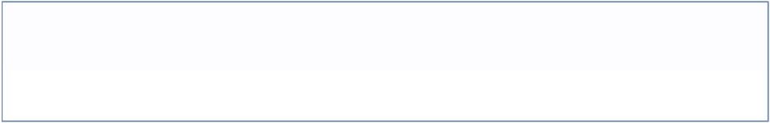
pred_fwd_lda = predict(alcohol_fwd_lda, newdata=alcohol)
confm_fwd = table(alcohol$TYPE, pred_fwd_lda$class)
confm_fwd
typeA | typeA 18 | typeB 0 | typeC 0
typeB | 0 | 22 | 7
typeC | 0 | 8 | 22
error = 1 - sum(diag(confm_fwd)) / sum(confm_fwd)
error
[1] 0.1948052
>
▪

Slide 11

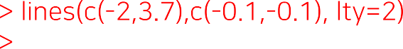
3
B
C
2
C
C _{B}
C
C
CC
pred_alc$x[, 2]
1
A
A
C
C
C C
C
A
C
_{B}C
C
C C
AA
AA
_{B}C
A A
A^{A}
C
BC
C
0
A A
C
B B
CB
BC
_{B} C
C ^{B} B
A
_{C}B
B B
B
-1
A
A
A
C _{C}
B
B
C
B
A
B
B B
B
B B
-2
B
B
_{B}B
-4
-2
0
2
pred_alc$x[, 1]

Slide 12
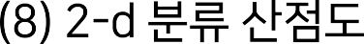

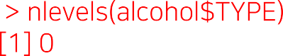
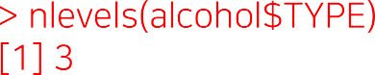










app. error rate: 0.273
Partition Plot
CCC CCC C
app. error rate: 0.325
10 40 70
app. error rate: 0.247
5 20
B ^{B}B
^{C} C ^{CC} B
A ^{A}A^{A}AAAA^{A}AA^{AA}
5 20
_{CBB}C _{B}CCCCC
MEPR
^{B}C C ^{C}C
BU1
C C B C^{C}BBB_{B}BBCB_{C} C CC
B^{BB}CB^{C}BBCB^{BC}B ^{CCB}C ^{C}
BU1
AA ^{B CCBCCC C} C
_{B} ^{BB}_{B}^{C}BC^{BC C BC C B}
C
C
^{B}_{B}CB_{B}B^{CBBB}C^{CBC}C ^{C}
^{AA}A^{A} A ^{CB}B^{BC}
C B
^{CC} CB^{CB}
^{AAAC}C^{CBB}BC ^{BBC} C
^{AAB B}C^{C}B^{C}B^{BBC}B^{B}
10 30 50 70
AAA^{AAAAA}
CB BB^{B}
0 500 1000 1500
MEPR
0 500 1000 1500
MEOH
MEOH
app. error rate: 0.286
app. error rate: 0.442
app. error rate: 0.299
_{B}CCCC
B
MEPR
10 40 70
^{B}C_{CC}
MEOH
0 1000
CC^{C C}C^{C}
BU1
5 20
B CBB^{B}C_{C}^{B}C_{B}^{CC}C_{B}^{C}BC ^{B} B ^{BB BB}
^{B C}C_{C}^{C}C^{CC} _{C} B_{A}
_{BBCB}BC_{B}C_{C}BB_{CB}CCCBCC _{BCB} BB BB
B _{C}BB ^{B}CC CC C BB
C^{B}_{A}^{CAC} A^{A} A ^{B}A
BCCC^{BC B} B ^{B B}
B _{B}
B
_{A} C^{B}C_{A AA}AB_{A} ^{A}_{AAA}B
^{B} C^{CCC B}
^{A}CBC_{C}B ^{ACAB}A^{AC}CB_{B}CB BA^{BBB}
B
_{A} A A
A AAAA^{A} AA ^{AAA}A
100 300
^{A}BBC^{C}BB
BB
A
^{C B}B
A
ACET
100 300
100 300
ACET
ACET
app. error rate: 0.286
app. error rate: 0.39
app. error rate: 0.286 _{C} ^{C} C
5 20
CCCC C C
C
MEPR
10 40 70
C ^{B}
C
MEOH
0 1000
B^{CC}B^{CBC}BB^{BC}BB^{C} C ^{C}CBB^{CBC}
BU1
BBCC^{BB} C^{C}C^{BB}
^{CCBC}C^{C}C^{C C CC}C
C
C A
_{CC}B_{B}CBB^{B}BB_{BBB C C} C _{B}C
^{CB} B ^{A}A^{A}
B^{CBCCB} B^{BC}CC^{BC}
C
B_{B}CB C
A^{C BB}B A ^{C}B^{A}AA^{A}
A A
C ^{BBBB}BC B CA A
C B_{C}C_{B}
C ^{C}B^{C}BCB_{B}BBB _{B}^{BC} _{A}^{A} C^{C} C_{B}
A
_{A} A^{A}A^{A}A^{A}A^{AA}
A AA A^{A}AA^{AAAA A} 4 5 6 7 8
^{B C} B ^{BB}
A A
LNPRO1
4 5 6 7 8
4 5 6 7 8
LNPRO1
LNPRO1
app. error rate: 0.481
ACET
100 400
BB
B BB ^{B}A^{A}
B_{B}BBB ^{B}C A^{A} A
A
CACC ^{C}B B_{C}^{B}CAACA^{CA C}
A
CC C_{C}^{CB}CC_{B}BC^{B}CB ^{C}C C ^{A}C ^{C B}C ^{C}
^{BB}_{B} BAA A
4 5 6 7 8
LNPRO1

Slide 13
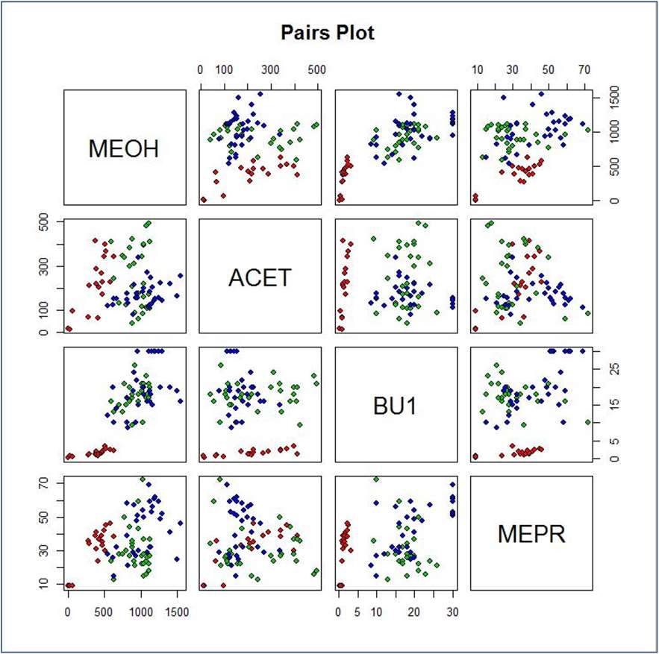
•

Slide 15
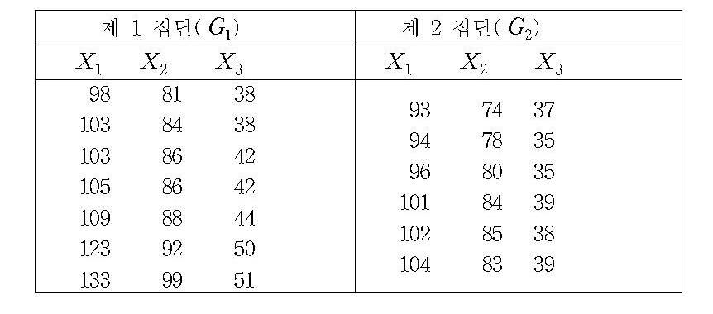
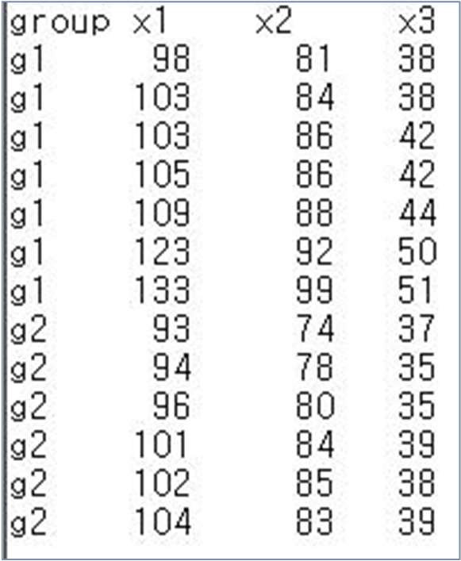

Slide 16

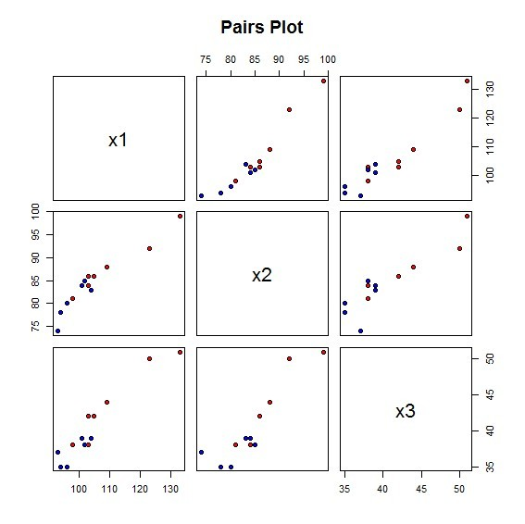
library(MASS)
data7 = read.csv(“c:/data/mva/data7-1.csv")
head(data7)
group | x1 | x2 | x3
1 g1 | 98 | 81 | 38
2 g1 | 103 | 84 | 38
3 g1 | 103 | 86 | 42
4 g1 | 105 | 86 | 42
5 g1 | 109 | 88 | 44
6 g1 | 123 | 92 | 50
data7$group = factor(data7$group)
pairs(data7[2:4], main="Pairs Plot",
pch = 21, bg = c("red", "blue")[unclass(data7$group)])

Slide 17

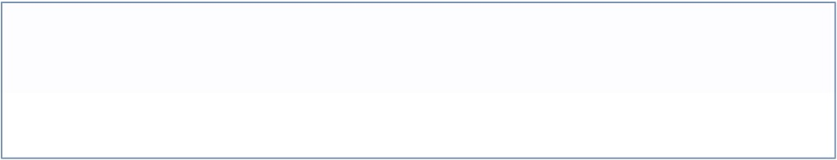
data7_lda = lda(group ~ ., data=data7)
data7_lda Call:
lda(group ~ ., data = data7)
Prior probabilities of groups: g1 g2
0.5384615 0.4615385
Group means:
x1 x2 x3 g1 110.57143 88.00000 43.57143
g2 98.33333 80.66667 37.16667
•
Coefficients of linear discriminants: LD1
LD1 = 0.273( x₁ − x₁ ) − 0.279( x₂ − x₂ ) − 0.513(x₃ − x₃ )
x1 | 0.2727114
x2 | -0.2794634
x3 | -0.5128692

Slide 18





pred_lda$class
g2 g2 g1 g1 g1 g1 g1 g2 g2 g2 g1 g2 g2 Levels: g1 g2
pred_lda$posterior
g1 g2
•
•
1 | 0.35014011 | 0.64985989
2 | 0.15881893 | 0.84118107
3 | 0.97194803 | 0.02805197
4 | 0.92101209 | 0.07898791
5 | 0.96899785 | 0.03100215
6 | 0.98515585 | 0.01484415
…
pred_lda$x
 | LD1
1 | 0.46371609
2 | 0.98888267
3 | -1.62152084
4 | -1.07609809
5 | -1.56991779
6 | -1.94702728
…
•
•
•

Slide 19


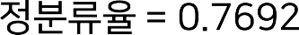
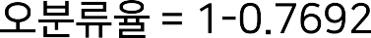
confm_lda = table(data7$group, pred_lda$class)
confm_lda
•
•
g1 g2
g1 5 2
g2 1 5
•
prop.table(confm_lda, 1)
g1 g2
g1 0.7142857 0.2857143
g2 0.1666667 0.8333333
sum(diag(prop.table(confm_lda))) [1] 0.7692308

Slide 20

data7_forward = greedy.wilks(group ~ . , data=data7)
data7_forward
Formula containing included variables:
group ~ x3
<environment: 0x08830454>
Values calculated in each step of the selection procedure:
vars Wilks.lambda F.statistics.overall p.value.overall F.statistics.diff p.value.diff 1 x3 0.5766877 8.074448 0.01603713 8.074448 0.01603713
•

Slide 21


data7_fwd_lda = lda(data7_forward$formula, data=data7)
data7_fwd_lda
Prior probabilities of groups: g1 g2
0.5384615 0.4615385
Group means:
x3 g1 43.57143
g2 37.16667
•
•
Coefficients of linear discriminants:
LD1 x3 0.2468314
pred_fwd_lda = predict(data7_fwd_lda, newdata=data7)
confm_fwd = table(data7$group, pred_fwd_lda$class)
confm_fwd
g1 g2
g1 5 2
g2 0 6
error = 1 - sum(diag(prop.table(confm_fwd)))
error
[1] 0.1538462

Slide 23

import numpy as np import pandas as pd # 데이터 읽기
alcohol = pd.read_csv("c:/data/mva/alcohol.csv") alcohol.head()
Out[1]:
TYPE
typeA
typeA
typeA
typeA
typeA
MEOH 3.0
23.0
65.0
279.0
292.0
ACET 15.0
13.0
96.0
66.0
210.0
BU1 MEPR ACAL LNPRO1 0.2 9.0 9.0 5.86
0.8 9.0 2.0 6.67
0.4 9.0 4.0 5.31
0.9 36.0 4.8 5.45
1.1 34.0 8.0 4.08

Slide 24
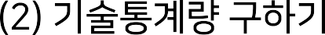

# 기술통계량 구하기 alcohol.describe() Out[2]:
 | MEOH | ACET | BU1 | MEPR | ACAL | LNPRO1
count | 77.000000 | 77.000000 | 77.000000 | 77.000000 | 77.000000 | 77.000000
mean | 845.629870 | 211.666234 | 14.741558 | 35.755844 | 12.505195 | 5.300519
std | 329.673058 | 114.766325 | 8.831513 | 14.535460 | 5.326594 | 1.108275
min | 3.000000 | 13.000000 | 0.200000 | 9.000000 | 2.000000 | 3.300000
25% | 620.000000 | 127.000000 | 9.300000 | 26.000000 | 8.600000 | 4.280000
50% | 910.000000 | 181.000000 | 17.000000 | 33.000000 | 11.000000 | 5.260000
75% | 1087.000000 | 287.000000 | 20.000000 | 46.000000 | 15.000000 | 6.220000
max | 1548.000000 | 495.000000 | 30.000000 | 72.000000 | 28.000000 | 8.010000
als_stat = alcohol.describe() als_stat.loc["mean"]
Out[6]:
MEOH | 845.629870
ACET | 211.666234
BU1 | 14.741558
MEPR | 35.755844
ACAL | 12.505195
LNPRO1 | 5.300519
Name: mean, dtype: float64 als_stat.loc["mean"][0] Out[7]: 845.6298701298701

Slide 25


# 선형판별분석 실행
from sklearn.discriminant_analysis import LinearDiscriminantAnalysis clf = LinearDiscriminantAnalysis()
clf.fit(X,y) clf.fit_transform(X,y)

Slide 26

# 분류하기
pred_class = clf.predict(X) pred_class[0:5]
Out[10]: array(['typeA', 'typeA', 'typeA', 'typeA', 'typeA'], dtype='<U5')
# 사후확률(posterior prob) 구하기 pred_posterior = clf.predict_proba(X) pred_posterior[0:5, :]
Out[11]:
array([[9.99993239e-01, 4.87823329e-06, 1.88255897e-06], [9.99983817e-01, 1.10451922e-05, 5.13759904e-06],
[9.99862118e-01, 1.21615116e-04, 1.62666780e-05], [9.99906685e-01, 3.76892586e-05, 5.56261564e-05], [9.99326691e-01, 5.52743277e-04, 1.20565359e-04]])

Slide 27

# 분류표 구하기
from sklearn.metrics import confusion_matrix confusion_matrix(y, pred_class)
Out[12]:
array([[18, | 0, | 0],
[ 0, | 23, | 6],
[ 0, | 9, | 21]], dtype=int64)
# 오분류율 구하기
from sklearn.metrics import accuracy_score print('Accuracy = '+str(accuracy_score(y, pred_class)))
Accuracy = 0.8051948051948052
print('Error rate = '+str(1-accuracy_score(y, pred_class))) Error rate = 0.19480519480519476

Slide 28


Slide 29

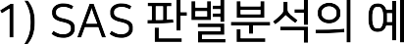
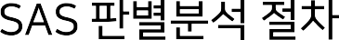
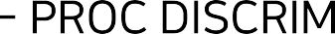




Slide 30
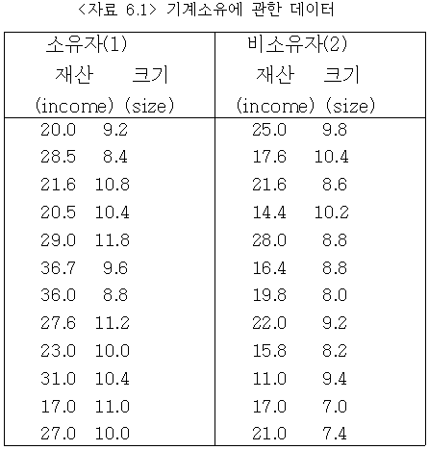

Slide 31
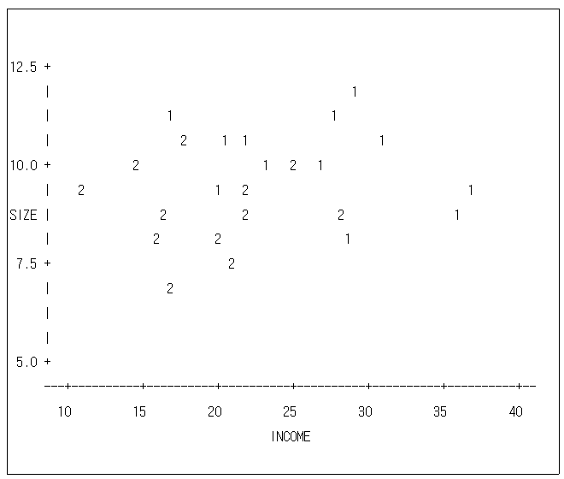

Slide 32
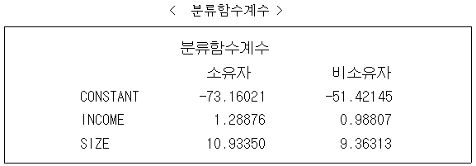

Slide 33
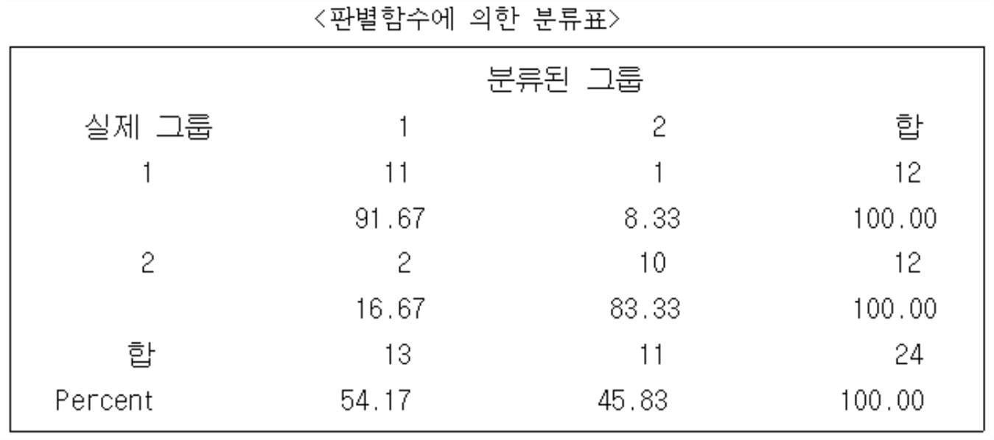

Slide 34
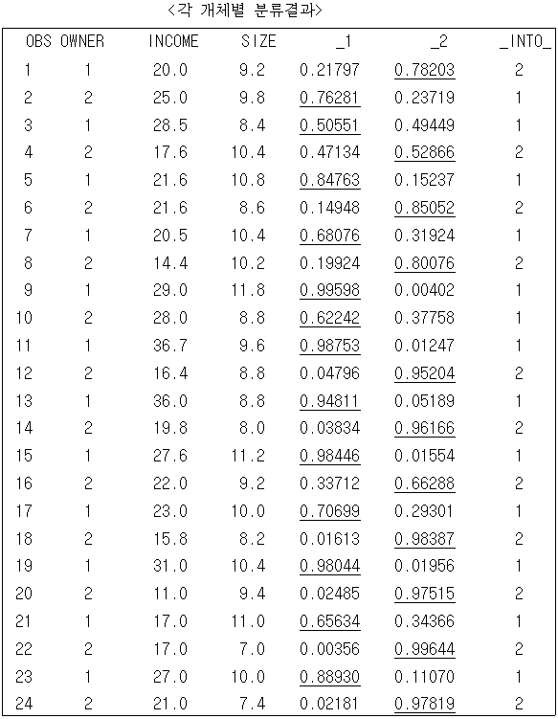

Slide 35

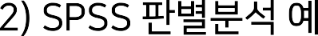
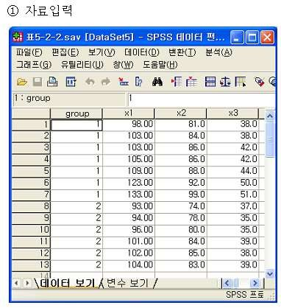

Slide 36
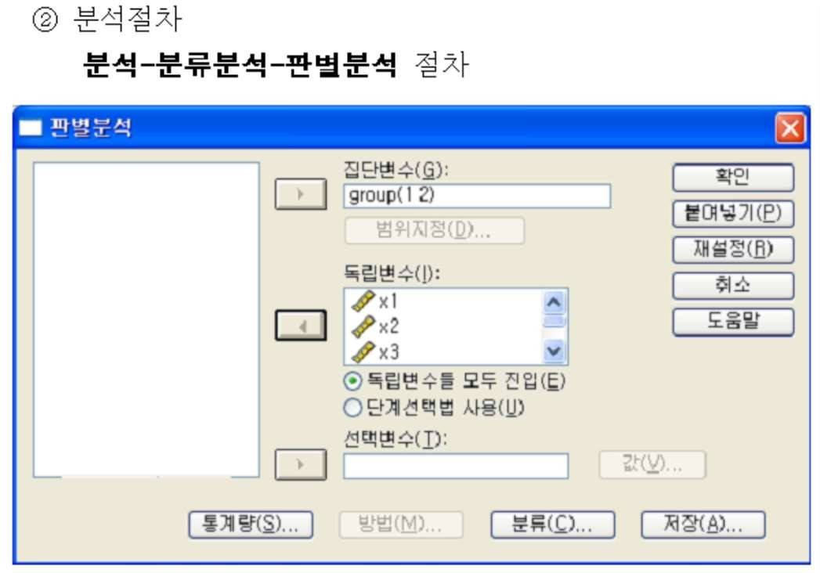
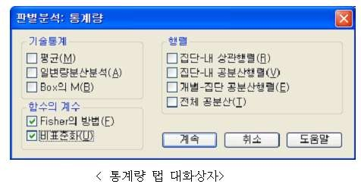
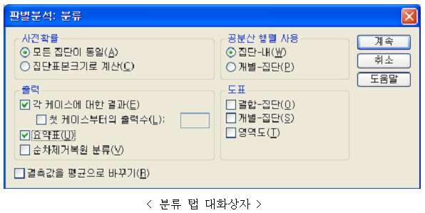

Slide 37




